Slide 1



Part 2: Presentation Task
Gym Exercise Tracking & Analysis System
Done By: Mohamed Hamdy Ghaly
SEE (Sports Education Enhancer)

Slide 2

Table of
CONTENTS
01
02
03
04
Problem Overview
Proposed Solution
Objective Introduction
Pipeline Discussion
05
06
07
08
Model selection
Data Collection and Annotation
Training Process
Model Usage
09
Challenges

Slide 3
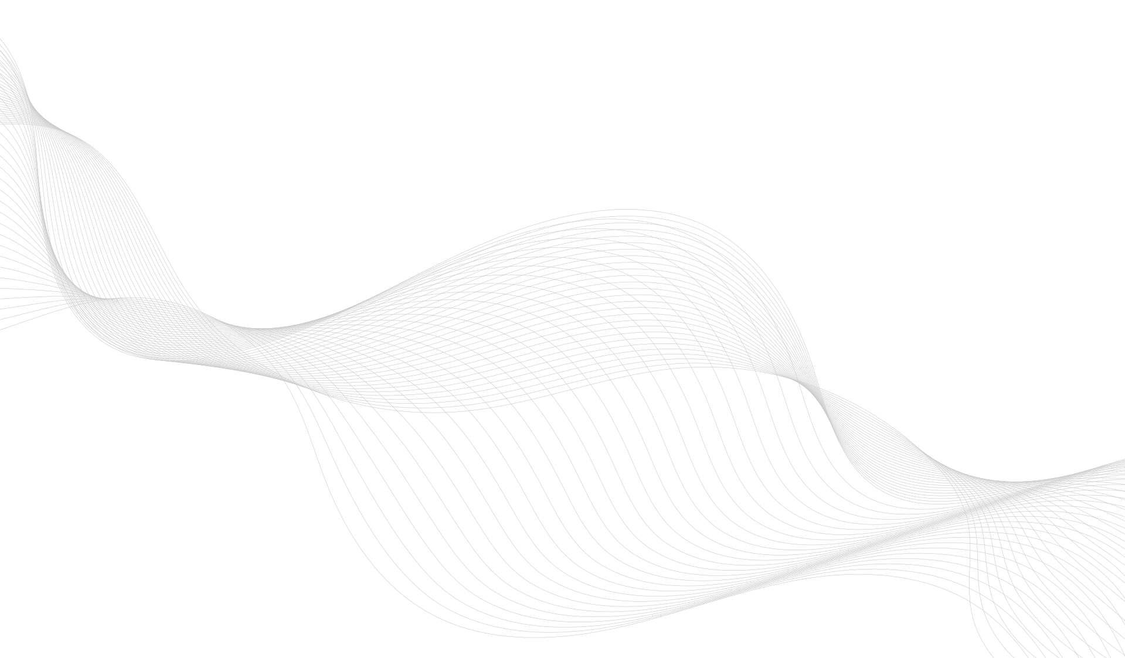
Problem Overview
According to the National Library of Medicine: Injuries during free weight activities account for the majority of exercise-related incidents, including 84.4% of crush injuries caused by falling or dropped weights. Overexertion and unnatural movements are also significant contributors, with about 8% of emergency room visits resulting in hospitalization, most commonly due to free weight accidents, trips, and falls in gym settings.

Slide 4



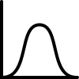

Proposed Solution
Camera Input: Capture user movements via webcam or smartphone
Pose Estimation: Detect joints and body angles using AI models.
Load Distribution: Estimate stress on arms, knees, hips, etc.
Injury Risk Assessment: Identify posture issues and risks during motion

Slide 5
Intelligent Exercise Tracking and Analysis System
Objective
Designing a system that uses computer vision to:
Track user movement during exercises
Analyze posture, load distribution, and potential injury risks
Support two environments:
Single user at home
Multi-user gym setting
Selected Exercises
They cover distinct body regions:
• Squats → Lower body, core, spinal alignment
• Bicep curls → Upper body, elbow and wrist mechanics
They allow us to demonstrate system capabilities in terms of joint tracking, form correction, and load estimation.

Slide 6
Intelligent Exercise Tracking and Analysis System
Movement Quality Analysis
Detect and evaluate joint angles and body posture
Identify deviations from correct exercise form (e.g., knee alignment in squats, elbow angle in bicep curls)
Provide corrective feedback to improve technique and efficiency
Load Distribution Metrics
Estimate forces and stresses on key joints: knees, hips, arms, chest
Analyze how weight and body mechanics affect joint loads during different exercises
Adapt estimates based on user posture and whether external weights are held
Injury Risk Assessment
Detect risky postures that increase strain or risk of injury (e.g., excessive knee valgus, hyperextension)
Warn users of improper form or overloading that could cause strain or injury

Slide 7

Pipeline Discussion

Slide 8
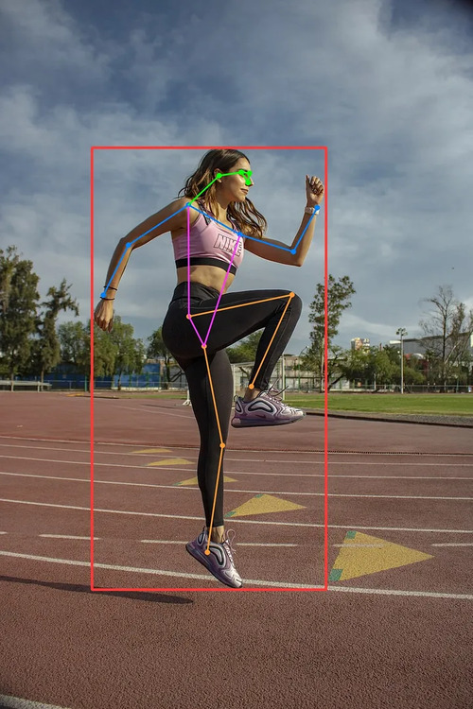
Model Selection: 2D Pose Estimation
2D Pose Estimation
Detects joint positions in a single image plane (x, y coordinates)
Lower computational cost and easier to deploy on devices like smartphones
Sufficient for many exercises with clear, frontal views (e.g., bicep curls)
Limitation: Limited depth information; may miss subtle 3D postural issues

Slide 9
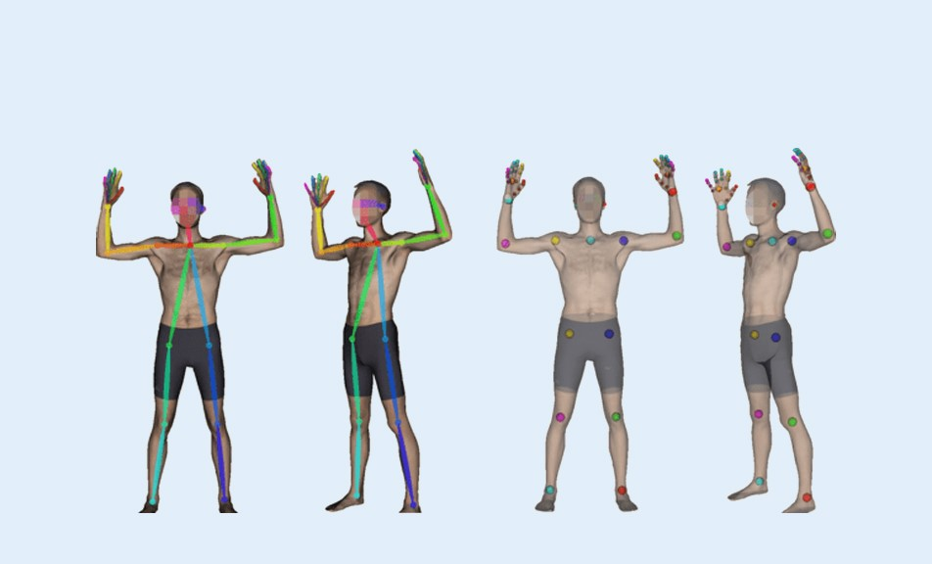
Model Selection: 3D Pose Estimation
3D Pose Estimation
Captures joint positions in three dimensions (x, y, z coordinates)
Provides richer spatial understanding of movements and angles
Better for complex exercises involving depth (e.g., squats, deadlifts)
Limitation: Higher computational requirements and may need multiple cameras or specialized sensors

Slide 10
Model Selection: 2D vs. 3D Pose Estimation
Single user at home
Multi-user gym setting
Criteria | 2D Pose Estimation | 3D Pose Estimation
Accuracy Needs | Suitable for basic tracking and form analysis | Better for detailed biomechanical analysis and precise joint angles
Hardware Constraints | Works well with single cameras, lower computational power | Requires multiple cameras or depth sensors and higher computational resources
Use Case | Ideal for single-user at home setups | Suitable for multi-user gym environments with more complex setups
Latency & Real-Time | Faster processing, better for real-time feedback | Higher latency due to complexity, may affect real-time use

Slide 11
Data Collection and Annotation
Aspect | Details
Data Collection | Record videos of users performing squats and bicep curls using smartphones or gym cameras. Collect data in varied environments: home setups and multi-user gyms. Capture diverse body types, clothing, lighting, and backgrounds for better generalization.
Annotations | Joint positions (keypoints) for major body parts (e.g., elbows, knees, hips). Joint angles calculated from keypoints for biomechanical analysis. Load distribution metrics estimated from posture and angles. Labels for correct vs. incorrect form and injury-risk postures.

Slide 12

Pre-trained Model
Use pre-trained models (e.g., OpenPose, MoveNet, or HRNet) as a base to leverage large-scale pose datasets.
Fine-tuning on Exercise Dataset
Apply transfer learning to fine-tune the model on exercise-specific datasets (squats, bicep curls).
Training Process Slide
Data Augmentation (rotation, scaling, lighting, etc.)
Consider data augmentation (rotations, scaling, lighting variations) to simulate real-world scenarios.
Model Evaluation & Cross-validation
If needed, train custom models on collected domain-specific data for improved accuracy.

Slide 13

Ensuring Model Generalization
01
Collect diverse training data covering different body types, ages, and fitness levels.
02
Use cross-validation techniques to evaluate model performance across unseen user groups.
03
Include samples from varied environments (home gyms, commercial gyms, different lighting conditions).
04
Regularly update the model with new data and retrain to handle evolving use cases.

Slide 14
Model Usage: Deployment Modes
Real-Time
Immediate pose estimation & feedback during exercise
Use case: Single User at Home (smartphone/webcam) & Gym multi-user (edge/cloud)
Post-Processing
Analyze recorded sessions with detailed metrics
Use case: Gym multi-user (offline analysis for coaching)

Slide 15
Model Usage: Deployment Modes
Single User at Home
Runs on smartphone or laptop using webcam.
No internet needed, keeps data private.
Multi-User Gym
Cameras capture multiple users.
Edge devices or local servers run the model for quick results as well as Cloud used for detailed analysis and data storage.)

Slide 16
Model Usage: Key Considerations
Factor | Single User at Home | Multi-User Gym Environment
Latency | Low latency needed for instant feedback (smartphone/computer limited resources) | Moderate latency acceptable; may use edge/cloud for processing
Accuracy | High accuracy for form correction, simplified background | High accuracy required; environment more complex with clutter & lighting
User Feedback | Simple, intuitive UI (visual cues, alerts) | Detailed analytics dashboard for trainers and users

Slide 17
Insights into the challenges

Slide 18
Challenges
Data Variability: Different body types, clothing, and lighting affect model accuracy.
Occlusion & Multiple Users: Overlapping bodies in gym settings make tracking harder.
Real-Time Processing: Balancing speed and accuracy on limited hardware is tough.
3D Pose Complexity: 3D models need more data and compute power, limiting usability at home.
Injury Prediction Limits: Identifying all possible injury risks from video alone is challenging.
Privacy Concerns: Handling sensitive video data requires strong security and user trust.

Slide 19
References
https://pmc.ncbi.nlm.nih.gov/articles/PMC5005555/#:~:text=Injuries%20due%20to%20overexertion/strenuous,class%20(10%25%20each).
https://opensistemas.com/en/yolov8-pose-transforming-pose-estimation/
https://thinkpalm.com/blogs/human-pose-estimation-a-game-changer-in-healthcare-medical-rehabilitation/

Slide 20
Contacts
Mohamed Hamdy Ghaly
Tel.: +2 0122350872
Email: mohamdyghaly2002@gmail.com

Slide 21
Part 2: Presentation Task
Gym Exercise Tracking & Analysis System
Done By: Mohamed Hamdy Ghaly
SEE (Sports Education Enhancer)

